Slide 1
Sequence Alignment program
Intro to Bioinformatics - Final project
By Andres Candido

Slide 2
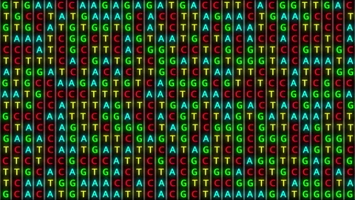
Some info about DNA sequences :
Actual Physical DNA is hard to manage and compare.
Because of this, DNA sequences are translated into text (ATGC) which can be easily viewed, stored, and manipulated through the use of computers.
This simplifies many tasks that scientists might want to perform on genomic data.
Additionally, translating DNA sequences into text also has some beneficial consequences when it comes to alignment algorithms.

Slide 3
DNA sequences are just long strings of text
DNA sequences are translated into text (ATGC), meaning that program that can align ANY form of text should follow the same logic as one that aligns DNA sequences.
This means that:
As long as the data given for alignment is analogous to reads in DNA sequencing, we can make a program that can align DNA without using any actual genomic data!

Slide 4
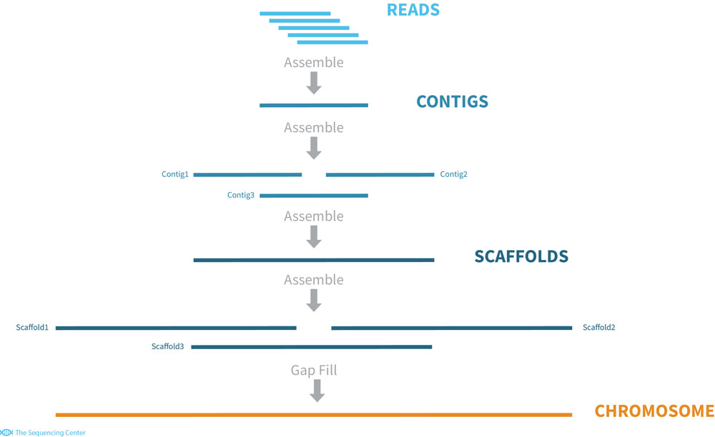
How DNA alignment is done:

Slide 5
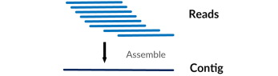
What I wanted to do:

Slide 6
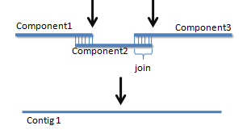
What I actually did:

Slide 7
Why?
Consequences?
Mostly due to time constraints
The program can align text and DNA sequences but can’t determine if a given read has an error (insertions, deletions, substitutions), so sometimes the final Contig can contain imperfections.
This is mostly because the majority of reads aren’t used in the alignment, which is bad when dealing with errors. But ok if we assume all sequences are perfect.

Slide 8
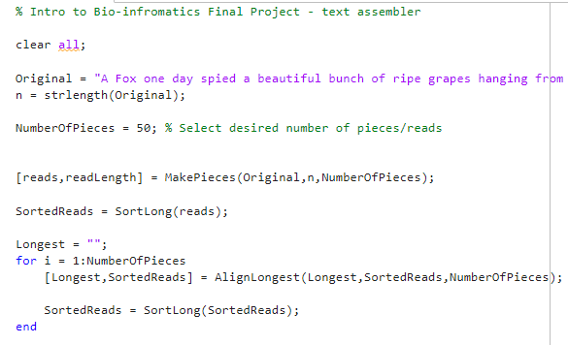
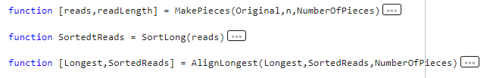
The program:

Slide 9
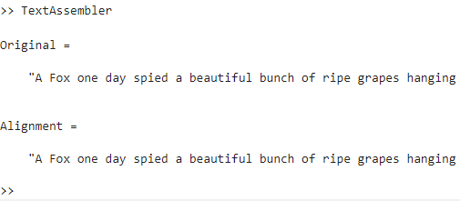
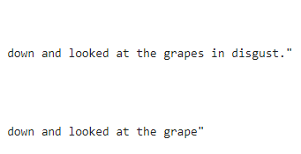
The final result:
…
This missing part here is due to none of the generated reads having that part.
Curiously, this loss of information at the ends of the text string is similar to what happens in the telomeres of actual chromosomes!

Slide 10
Questions?

Slide 11
Thank You!

